Slide 1




Programming Arcade games with Python
@snoopy_security
@Dal_T

Slide 2
Agenda
2 hour
Intro to Raspberry PI
Intro to Python
Writing you first game
Conditionals, Repetitions and other Python features
More command line games
Intro to Pygame
Simple Animations
Optional Walkthroughs
1 hour
Break
Setup PI Arcade
Playing arcade games

Slide 3
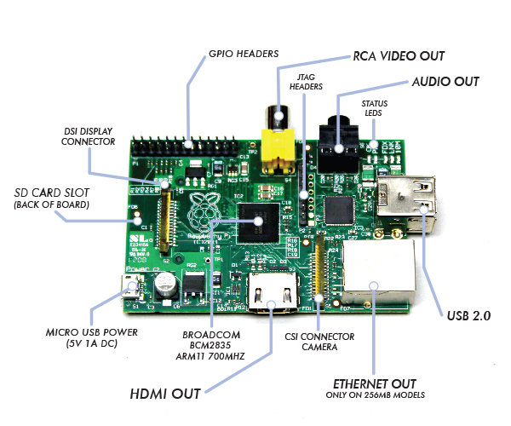
What is Raspberry Pi?

Slide 4
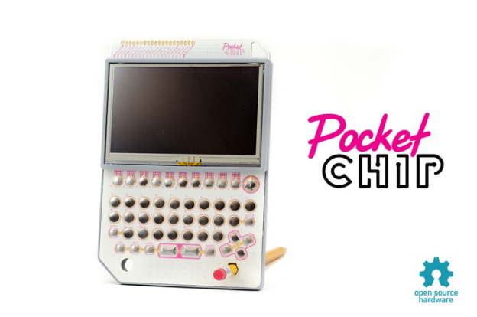
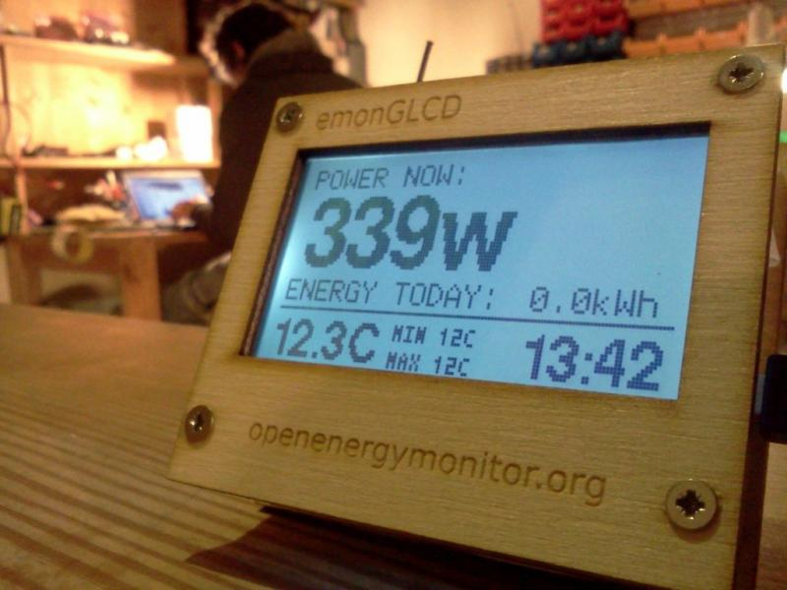
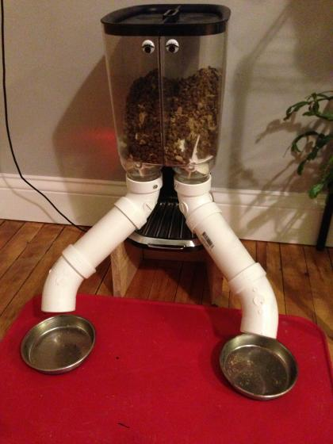
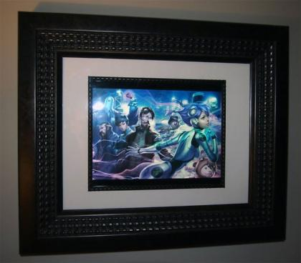
Why is it useful?

Slide 5
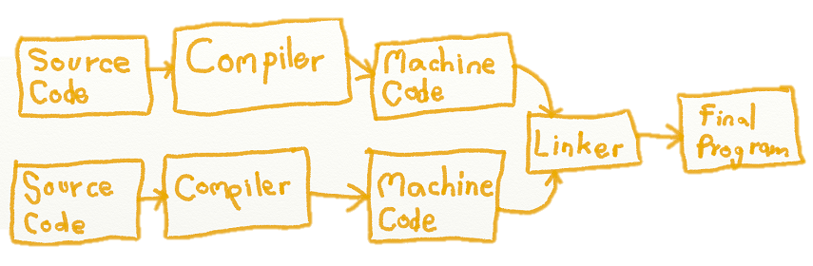
Programming Arcade games
It is important to learn how things work
Why Games? Because it is fun and easy

Slide 6
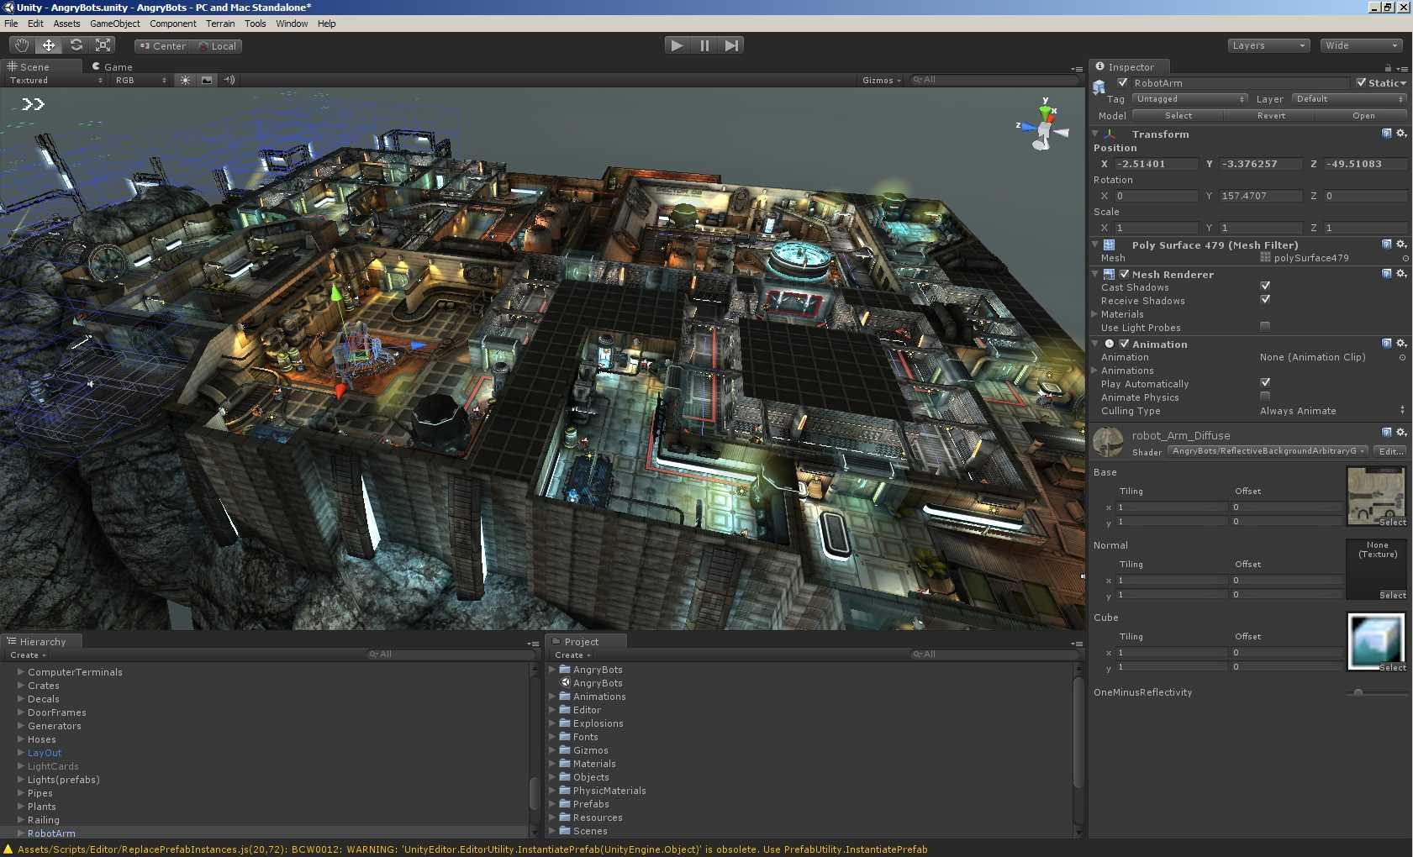
How 3D games are made
Unity – Powerful framework and gaming engine. Can write games in C#,
Java or Boo (fake python!).

Slide 7
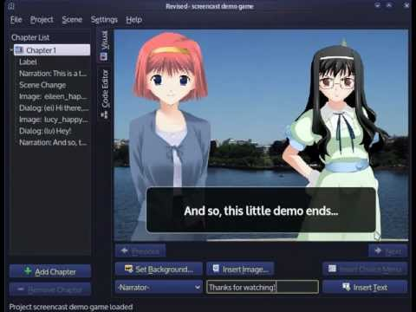
Ren’Py - Python based, interactive game engine

Slide 8
Python 101
Developed by Guido Van Rosson
Compiled vs Interpreted Languages
Heavily dependant on whitespaces
Plenty of resources online
Can run locally or cloud based IDEs
Python 2 vs Python 3

Slide 9
Python 101
Variables, Data types and functions
Using the python interpreter
Python 2 vs 3
Watchout for reserved words, whitespaces and syntax errors.
X=2
X = X + 2
print x
constant
Variable
Operator
Reserved word

Slide 10
Python 101- Variables and data types
#!/usr/bin/python
counter = 100 # An integer assignment
miles = 1000.0 # A floating point
name = "John" # A string
Operators
+ plus
- minus
/ divide
* multiply
% modulo (divide and finds the reminder)
< less-than
> greater-than
<= less-than-equal
>= greater-than-equal
== comparison

Slide 11
Python 101 - Sequential and conditional
.
print "I will now count my chickens:"
print "Hens", 25 + 30 / 6
print "Roosters", 100 - 25 * 3 % 4
x = 2
if x == 2:
print "x equals two!"
else:
print "x does not equal to two."
Now lets try a simple exercise!

Slide 12
Your Turn! Lets make a rock paper scissors game

Slide 13
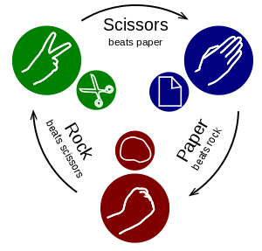
Game Logic
Always think and plan about your program logic before writing code.
Rock beats scissors
Paper beats rock
Scissors beats paper
Solve one piece of the puzzle at a time

Slide 14
Modules and Lists
Important thing about a list is that items in a list need not be of the same type.
list1 = ['physics', 'chemistry', 1997, 2000]
list2 = [1, 2, 3, 4, 5 ]
list3 = ["a", "b", "c", "d"]
A module is a file consisting of Python code. A module can define functions, classes and variables. A module can also include runnable code. E.g. random, math, pi, pygame etc
Built-in functions
float(), type(),str()

Slide 15
Python 101 - Repetition
For loops vs while loops
While loops repeat as long as a certain boolean condition is met.
For loops iterate over a given sequence.
numbers = [2, 3, 5, 7]
for number in numbers:
print number
count = 0
while count < 10:
print count
count += 1
print ‘The count is:’, count
# This is the same as count = count + 1
Lets try this!

Slide 16
New game: Guess the Number
You have 6 guesses to pick a number that the computer selected.

Slide 17
Functions
Used defined functions make code way more usable.
Can write making programs way more easier.
# Function definition is here
def printme(int1,int2):
print int1 + int2
return
# Now you can call printme function
printme(3,4)
printme(4,5)

Slide 18
One more challenge…..maybe??
Codecombat break

Slide 19
Pygame,Tkinter and Graphics
Pygame is a set of modules written for writing games. Pygame adds
functionality to easily create event handlers and import graphics.
GUI vs CLI. Do not require GUI to use all functions.
Good documentation and examples available.
Its simple and easy to use.
TkInter – Graphical User Interface package for python.

Slide 20
Simple Animation – Try this code
import sys, pygame
BLACK = 0, 0, 0
WHITE = 255, 255, 255
pygame.init()
screen = pygame.display.set_mode((640,480))
pygame.display.set_caption("Moving Box")
clock = pygame.time.Clock()
box_x = 300
box_dir = 3
while 1:
clock.tick(50)
for event in pygame.event.get():
if event.type == pygame.QUIT:
sys.exit()
screen.fill(BLACK)
box_x += box_dir
if box_x >= 620:
box_x = 620
box_dir = -3
elif box_x <= 0:
box_x = 0
box_dir = 3
pygame.draw.rect(screen, WHITE, (box_x, 200, 20, 20))
pygame.display.flip()

Slide 21
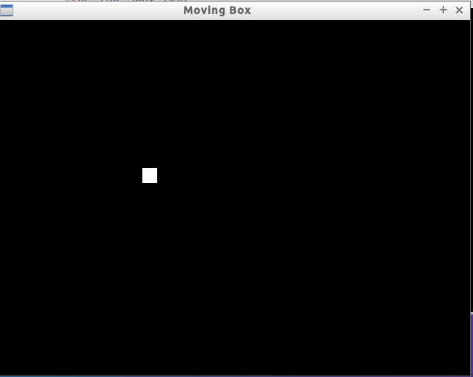
Simple animation

Slide 22

Tkinter for GUI Programming
from tkinter import *
master = Tk()
Label(master, text="First Name").grid(row=0)
Label(master, text="Last Name").grid(row=1)
e1 = Entry(master)
e2 = Entry(master)
e1.grid(row=0, column=1)
e2.grid(row=1, column=1)
mainloop( )

Slide 23
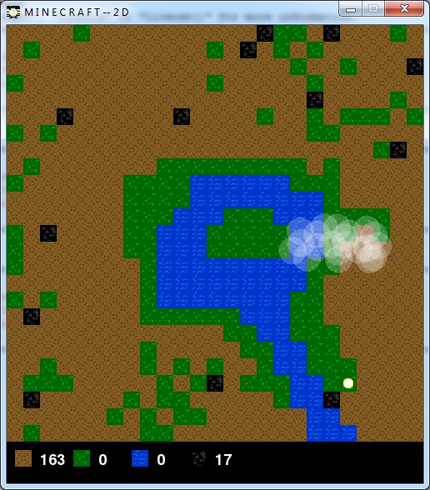
2D Minecraft (Optional)
Look at ‘www.usingpython.com/pygame/’. Try to follow through
and make the Minecraft game.

Slide 24

Tkinter Walkthrough (optional)
Go to www.usingpython.com/simple-gui-programming/ and try and build the below program.

Slide 25
Resources
Pygame.org
Pythontutor.com (good for visualisation)
Codecombat.com
Programarcadegames.com
Codeschool.com
Youtube.com/sentdexpython
All code and slides used today will be at github.com/snoopythesecuritydog

Slide 26

BREAK

Slide 27
Lakka (RetroArch)
Linux Distro with frontend RetroArch
Open source
Can emulate multiple console systems but require the correct BIOS to
work.
BIOS can be placed in the system folder and ROMs can be place on the
ROM folder. We will emulate Sega Genesis/MegaDrive, Super Nintendo games, because they require no BIOS to run.

Slide 28
Demo
Install Lakka using portable unetbootin
Go to emuparadise and romhustler and download interesting games.
Insert the preformatted SD Card and copy the game files.
Setup Raspberry PI and connect it to the monitor.
Browse the games, choose one and enjoy!

Slide 29

Fin!
Thank you for taking part!!
Thank you to the Big Daddy W aka my employer!!!
Thank you to our sponsors!!

